Slide 1




Store Design & Equipment
Jeff Miller
Sr. Director
jeff.j.miller@unfi.com
952-261-5266

Slide 2
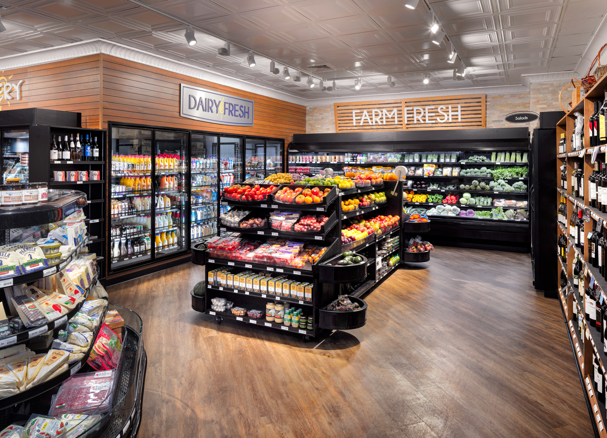
Store design & equipment
Benefits of a Remodel
Increase sales on average 5-8%
Increase your competitiveness
Stay relevant
Attract new customers
Create a better work environment for employees

Slide 3
Top 5 things customers want to experience in a grocery store
Store design & equipment
Seamless Experience
Fresh Merchandising & Local Options
Convenience & Easy Navigation
Clean & Updated Environment
Community Connection

Slide 4
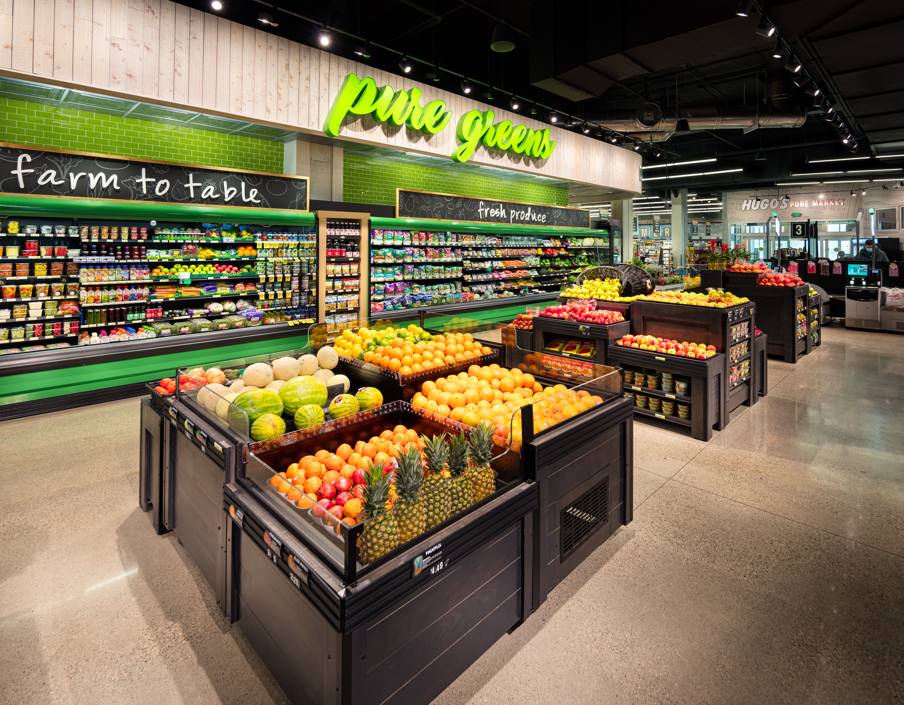
50+ years grocery & food service experience
Award winning designs
Leaders in innovative layouts & solutions
Equipment experts in cost savings & efficiencies
Store design & equipment
About Us
Inhouse team consists of:
  Store Planning
  Project Management
  Equipment Services
  Requirement Drawings
  Refrigeration Design
  Interior Design & Decor
Our mission is to grow retailer sales and profits through innovative designs and cost-effective solutions

Slide 5






Our Design Process
Store design & equipment
Kick Off Meeting
Store Planning & Budgeting
Project Management
Equipment Requirements
Equipment Quoting
Interior Design & Decor
Equipment Project
Equipment Project
Prior to issuing a Professional Service Proposal (PSP) we like having a meeting with the Retailer and our design team to talk about the overall scope, timing and Retailer’s vision.
Store Planner works with Retailer on concept floor plans, sharing inspirational photos and layout ideas. When complete, a concept budget for equipment is completed and approved before finalizing fixture plan.
Designer brings to life the look and feel of the store by creating custom drawings unique to the project goals. The design is then competitively bid and installed turnkey. Team collaborates with other project trades for a holistic store environment.
Project Manager becomes the single point of contact that offers the critical support needed between the design team, architect, contractor, equipment team and Retailer during the design process until project completion.
Store Planner and Project Manager work together to develop equipment and refrigeration requirement utility schedules, location drawings and responsibility matrix.
Equipment Project Coordinator is assigned to work with internal equipment experts on developing a detail equipment list while coordinating with the Project Manager and Retailer on shipment schedules.
After final fixture plan is complete our UNFI Account Manager will take lead to introduce you to the UNFI Shelf Management team to review their services with Macro Store Planning, Assortment & Execution and Market Intelligence. Click this link to learn more - Home | Professional Services (unfi.com)

Slide 6
Deliverables & Key Benefits
Store design & equipment
Store Planning
Concept fixture planning
Final fixture plan with exact equipment dimensions and tagged schedule
Expertise in grocery layouts for all store formats
Creative merchandising concepts and industry trends
Experienced planners with library of completed plans and inspirational photos
Collaboration with UNFI merchandising and shelf management teams
Project Management
  Concept equipment budget
  Equipment liaison between contractor, A&E, and Retailer
  Equipment delivery coordination with GC
  On site project coordination
  Experts in grocery store design and construction
  Provides project oversite to avoid costly mistakes
Requirement Drawings
  Equipment schedule for utilities
  Electrical location plan
  Data line location plan
  Plumbing and drain location plan
  Clearly defines project scope for contractors which saves time
  Avoids costly mistakes due to lack of details
  Retailer able to utilize local contractors and engineers that don’t have previous experience with grocery store projects
Refrigeration Design
  Custom refrigeration design (not brand specific which limits quoting)
  Equipment schedules
  Circuit, trenching, lighting, fan, defrost, anti-sweat plans
  Refrigeration rack legend
  Leverage industry expertise on proven design and results
  Consult with an expert on proven environmentally friendly systems and refrigerants
Equipment
  Customer Support team 1-800-835-0165 (equipmentservices@unfi.com) to assist with misc quote needs
Equipment Specialists that are experts in assigned categories
  Consolidated itemized equipment list with cutsheets for projects
  Obtain lower national account pricing by utilizing UNFI’s scale
  Vendor accountability through long-standing partnerships
Interior Design
  Interior elevations & finishes
  Lighting & decorative accent expertise
  Floor finish & environmental specifications
  Turnkey custom décor manufacturing & installation oversight
  Creative experts that design to all budgets & grocery store formats
  Deliver savings by competitively bidding décor packages
  Award winning designs focused on timeless environmental

Slide 7
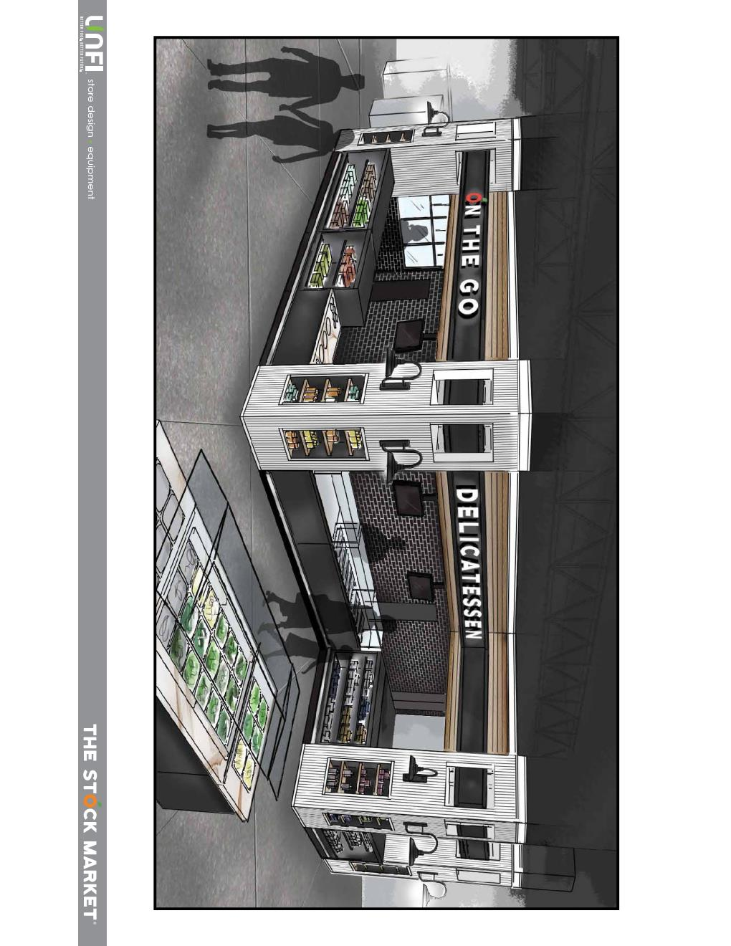
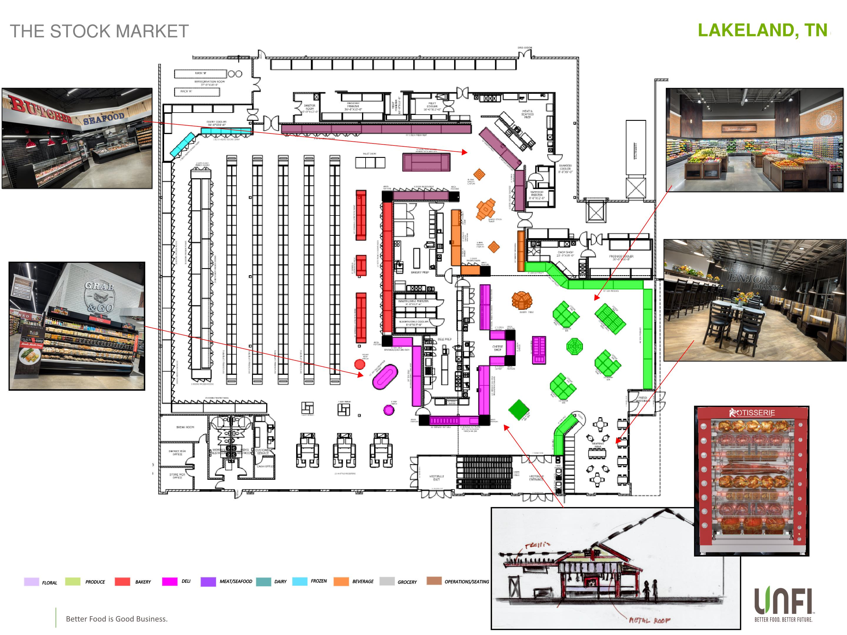
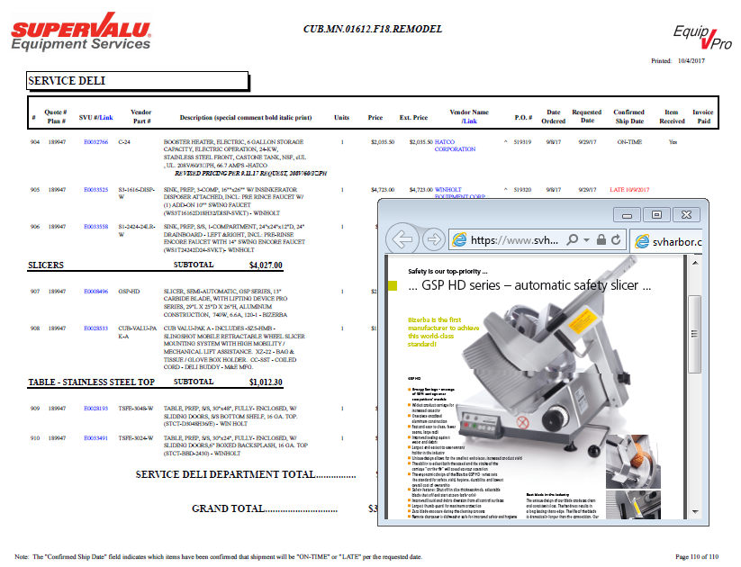


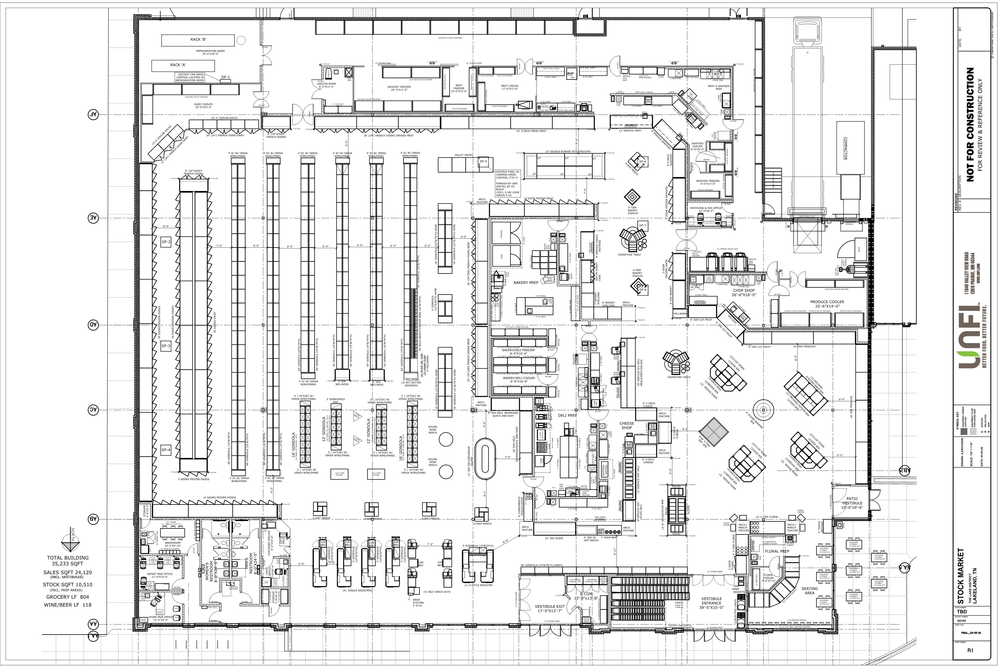
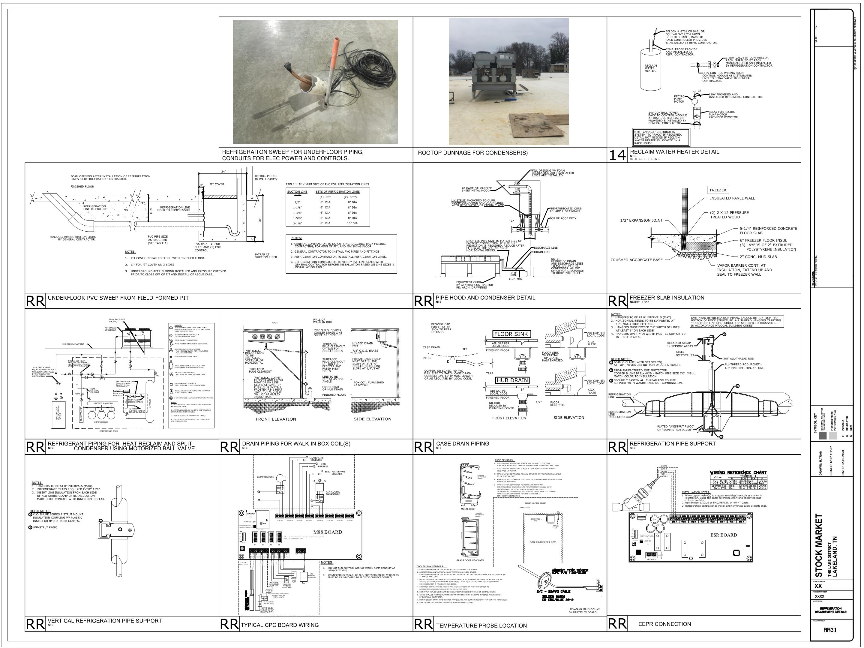
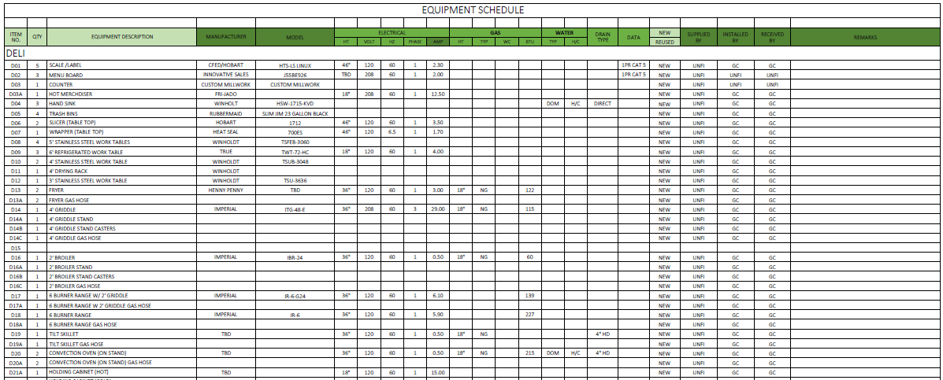

Recent Project Deliverables
Store design & Equipment

Slide 8












































Top National Account Vendors
Store design & Equipment
Precision Wire Products, Inc.

Slide 9
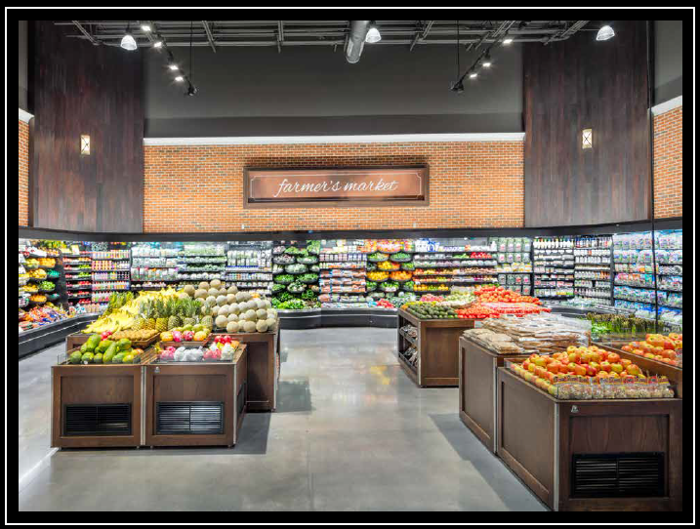
Lighting Design Service
New Services
Partnership with DMA Lighting - Boise ID
Detail SOW being added to new fee proposals
Deliverables:
  Conceptual lighting layout in a PDF format
  New light fixture placement with tags to fixture schedule
  Lighting schedule showing power requirements
  Specification sheet that corresponds to lighting schedule
Electrical Engineer is responsible for circuiting & electrical plans for permitting

Slide 10
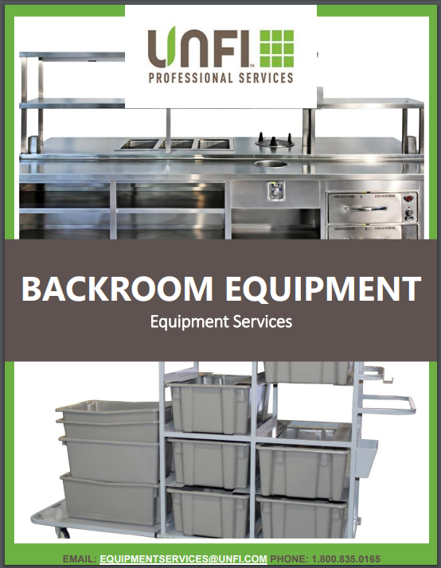

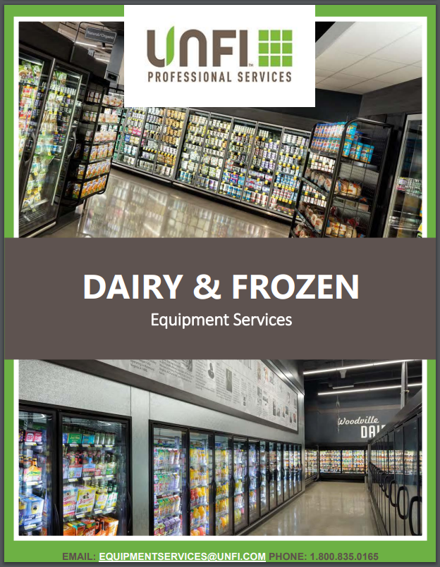
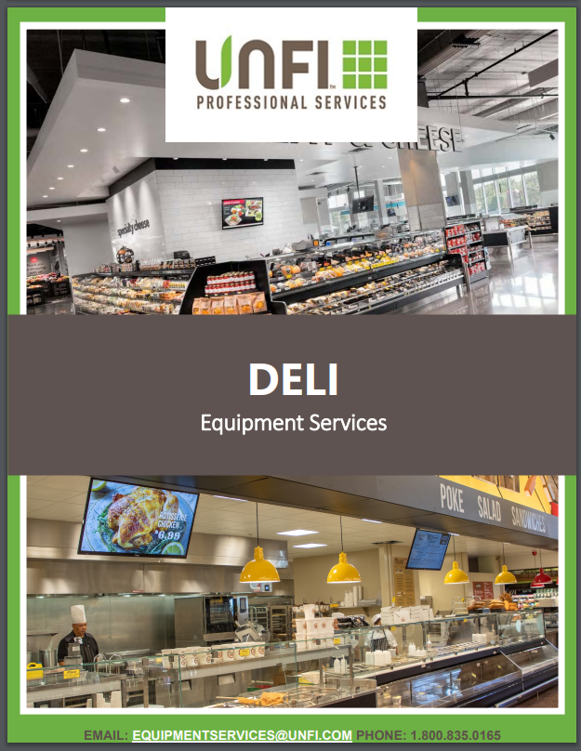
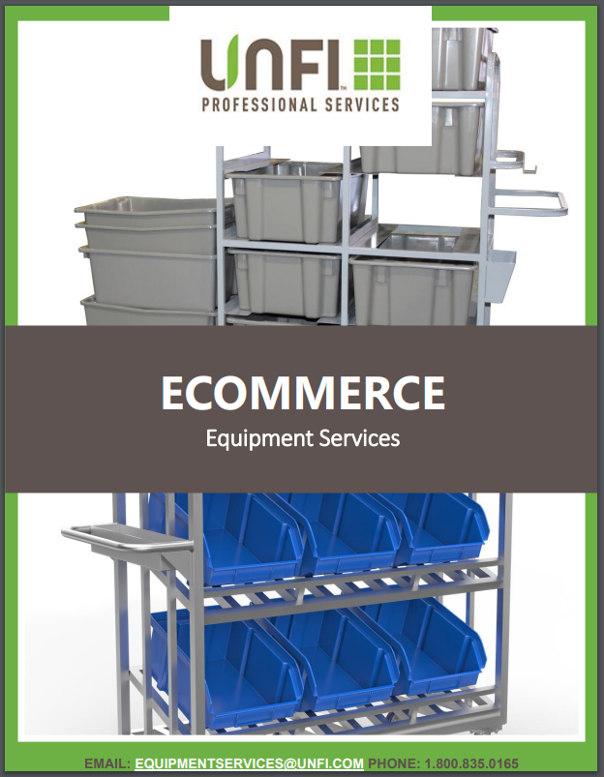
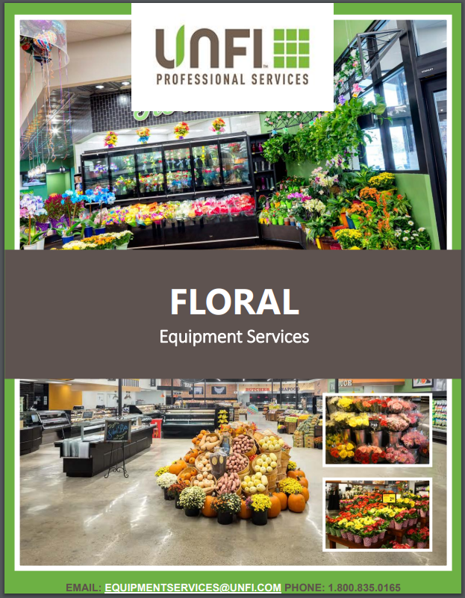
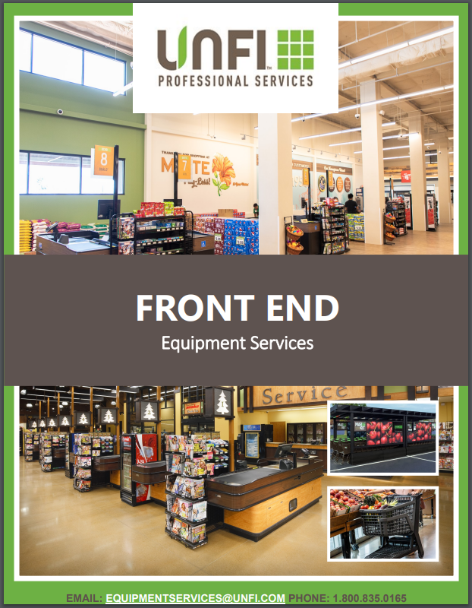
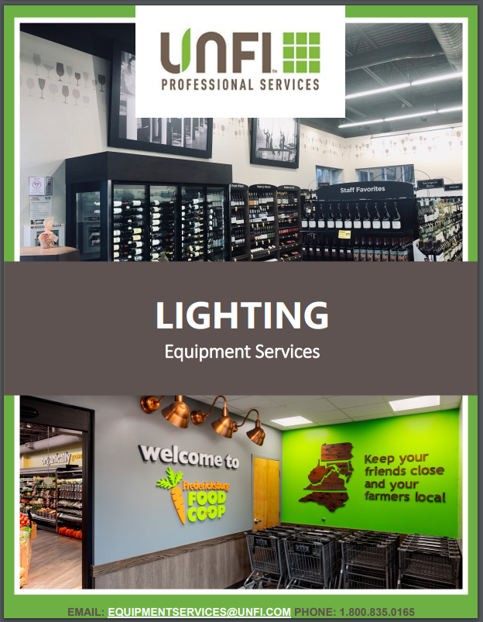
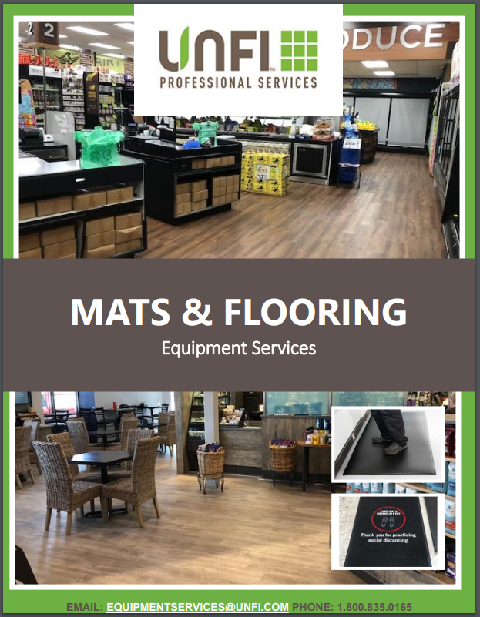
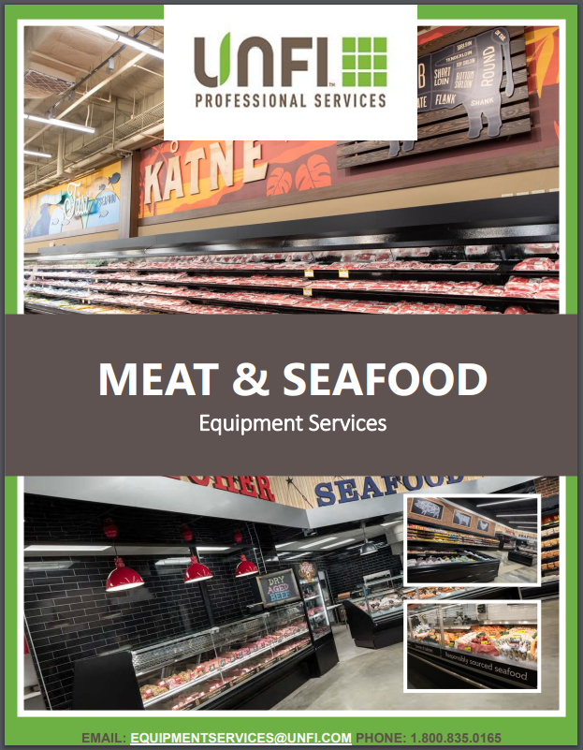
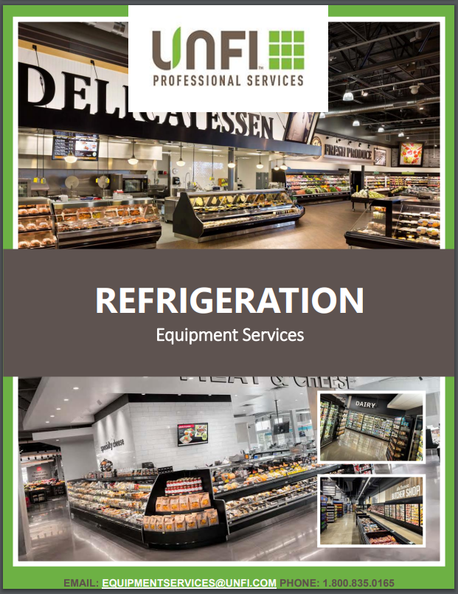
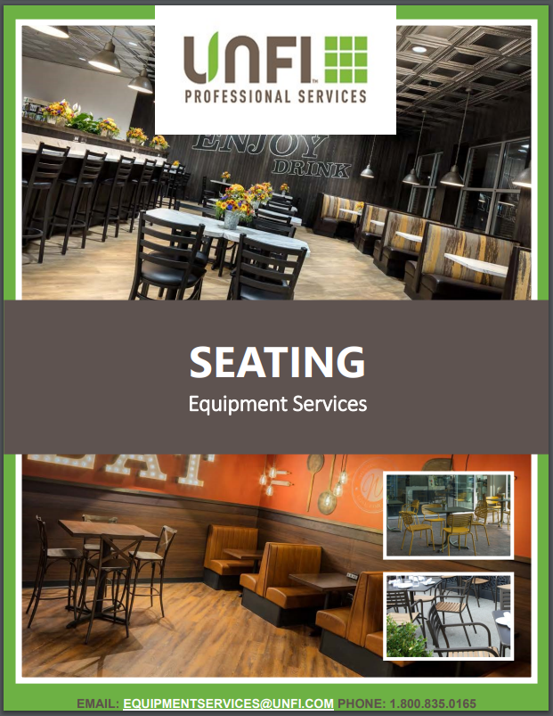
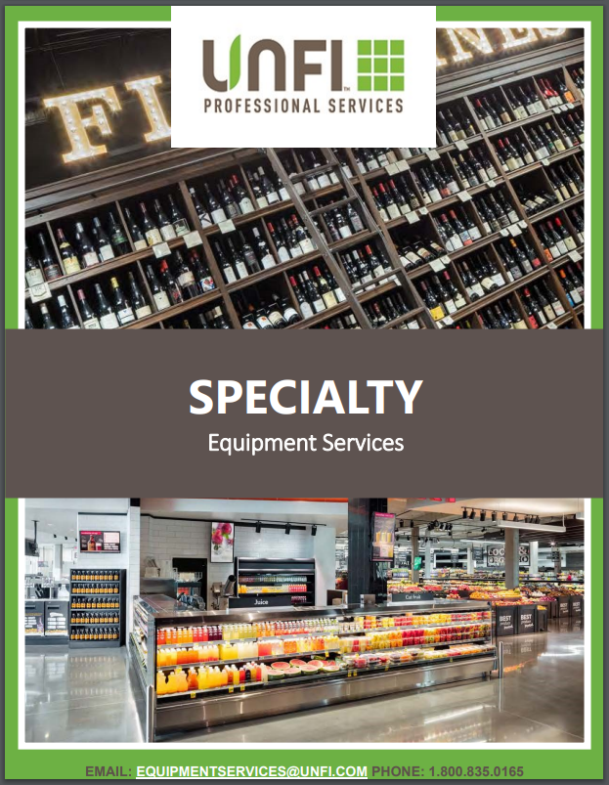
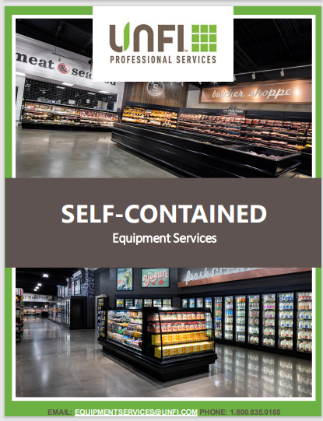
Equipment Catalogs
Store design & Equipment
Click Catalog To View Content

Slide 11
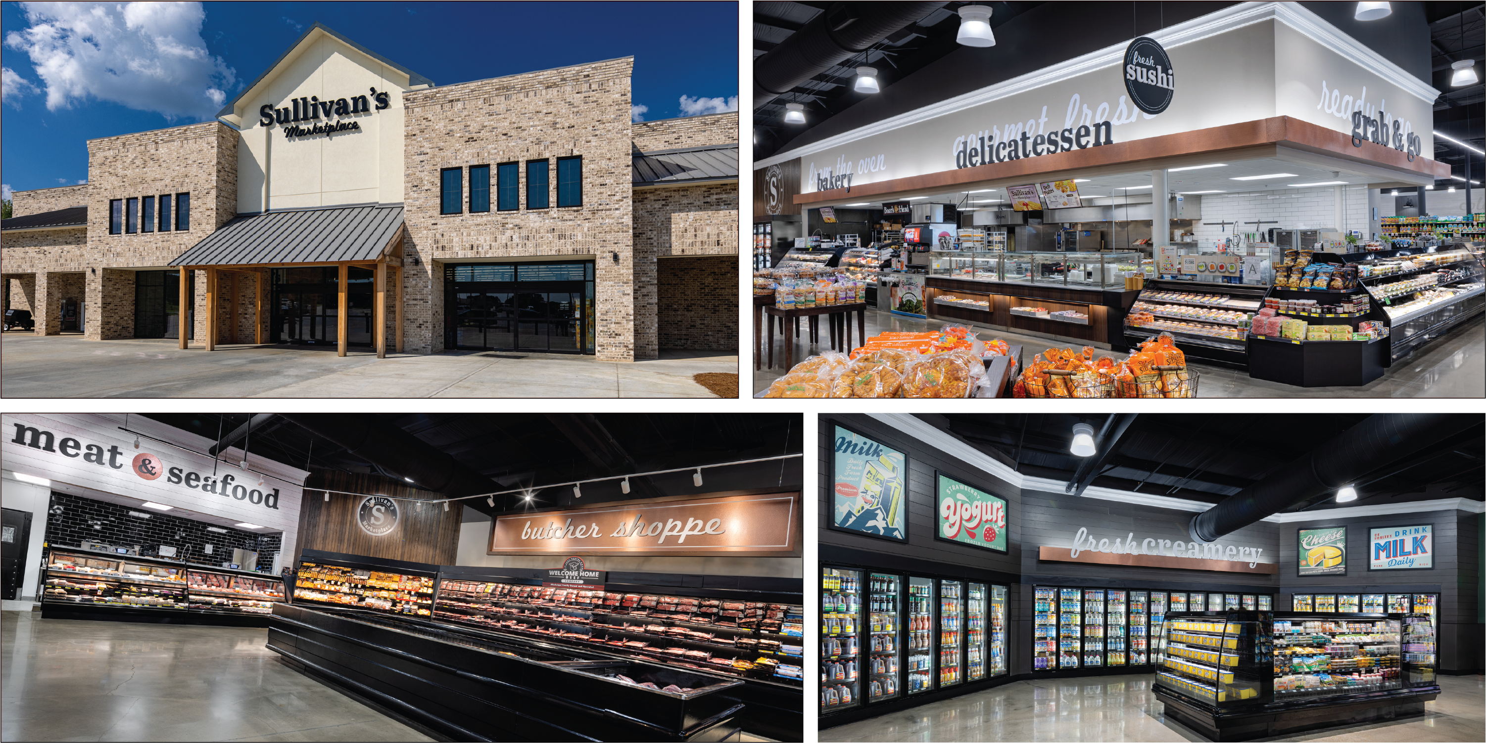
Sullivan’s Marketplace, Gluckstadt MS
Store design & equipment

Slide 12
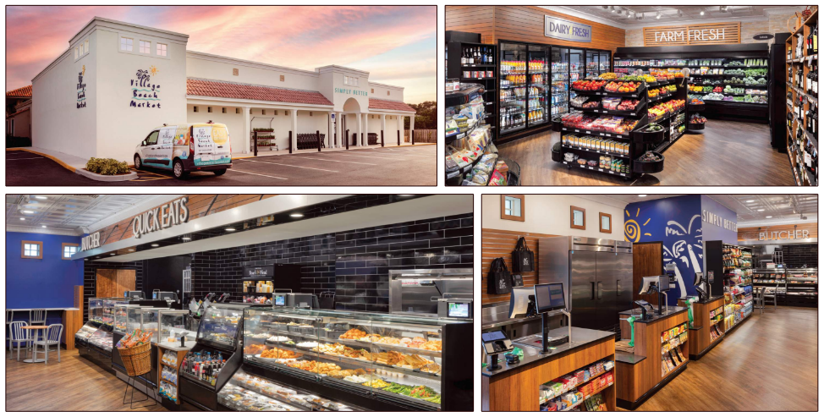
Village Beach Market, Vero Beach FL
Store design & equipment

Slide 13
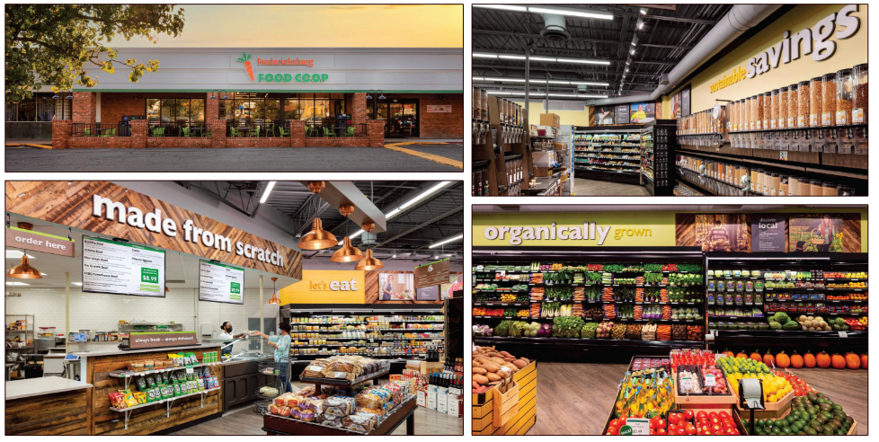
Fredericksburg Food Coop, Fredericksburg VA
Store design & equipment

Slide 14
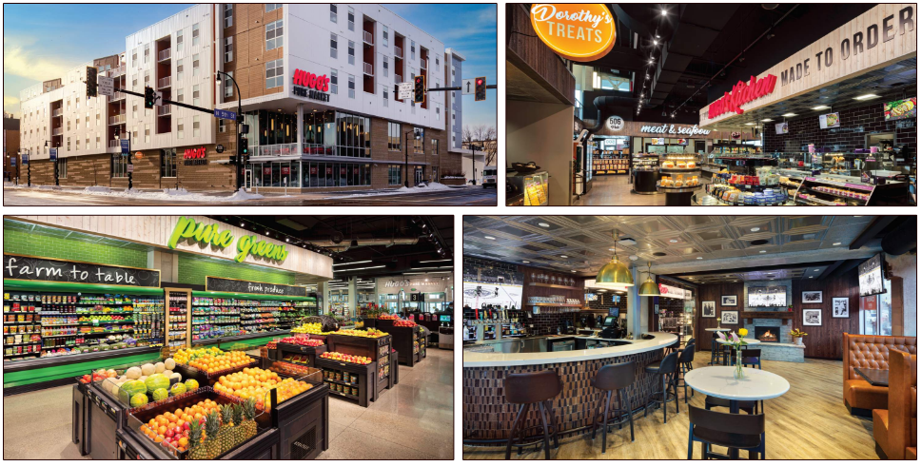
Hugo’s Pure Market, Grand Forks ND
Store design & equipment

Slide 15
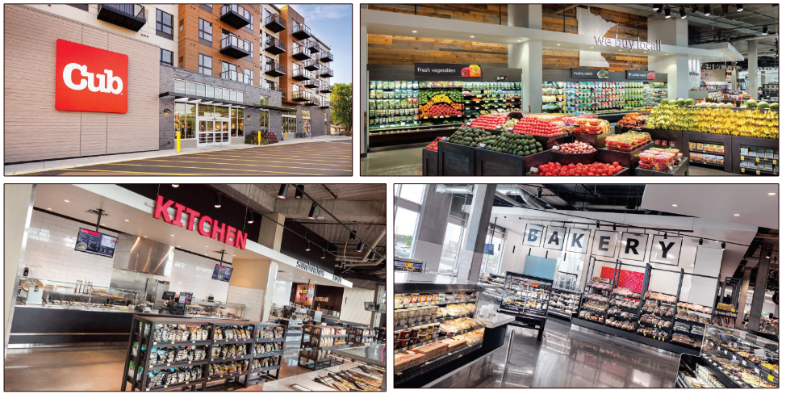
Cub, Minneapolis MN
Store design & equipment

Slide 16
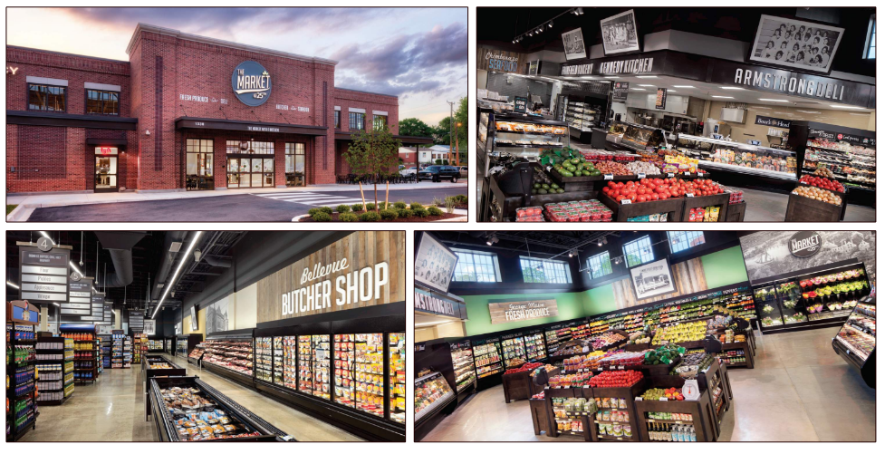
The Market @ 25th, Richmond VA
Store design & equipment

Slide 17
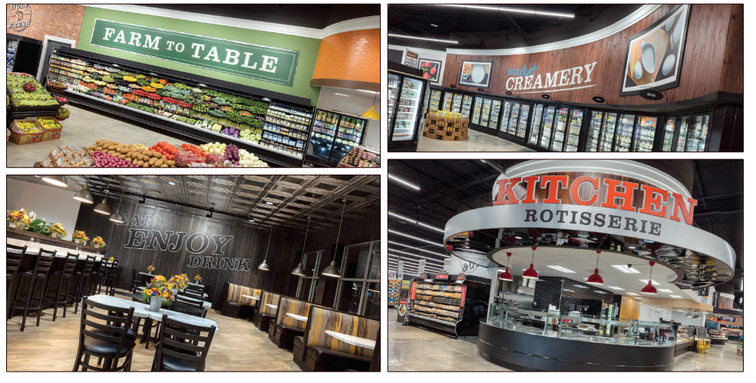
Corner Market, Hattiesburg MS
Store design & equipment

Slide 18
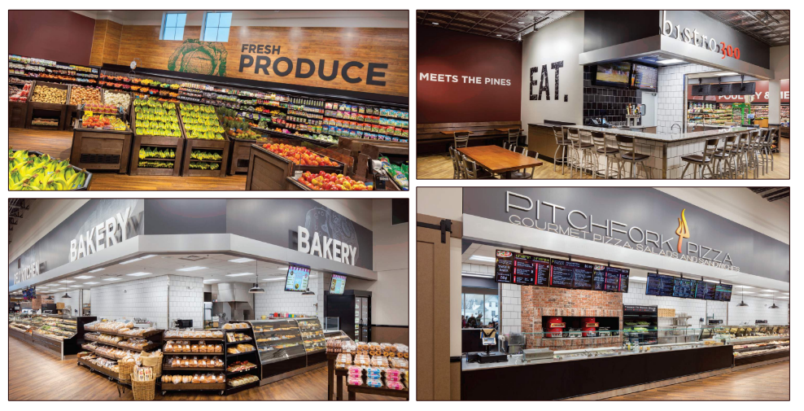
Palubicki’s, Fosston MN
Store design & equipment

Slide 19
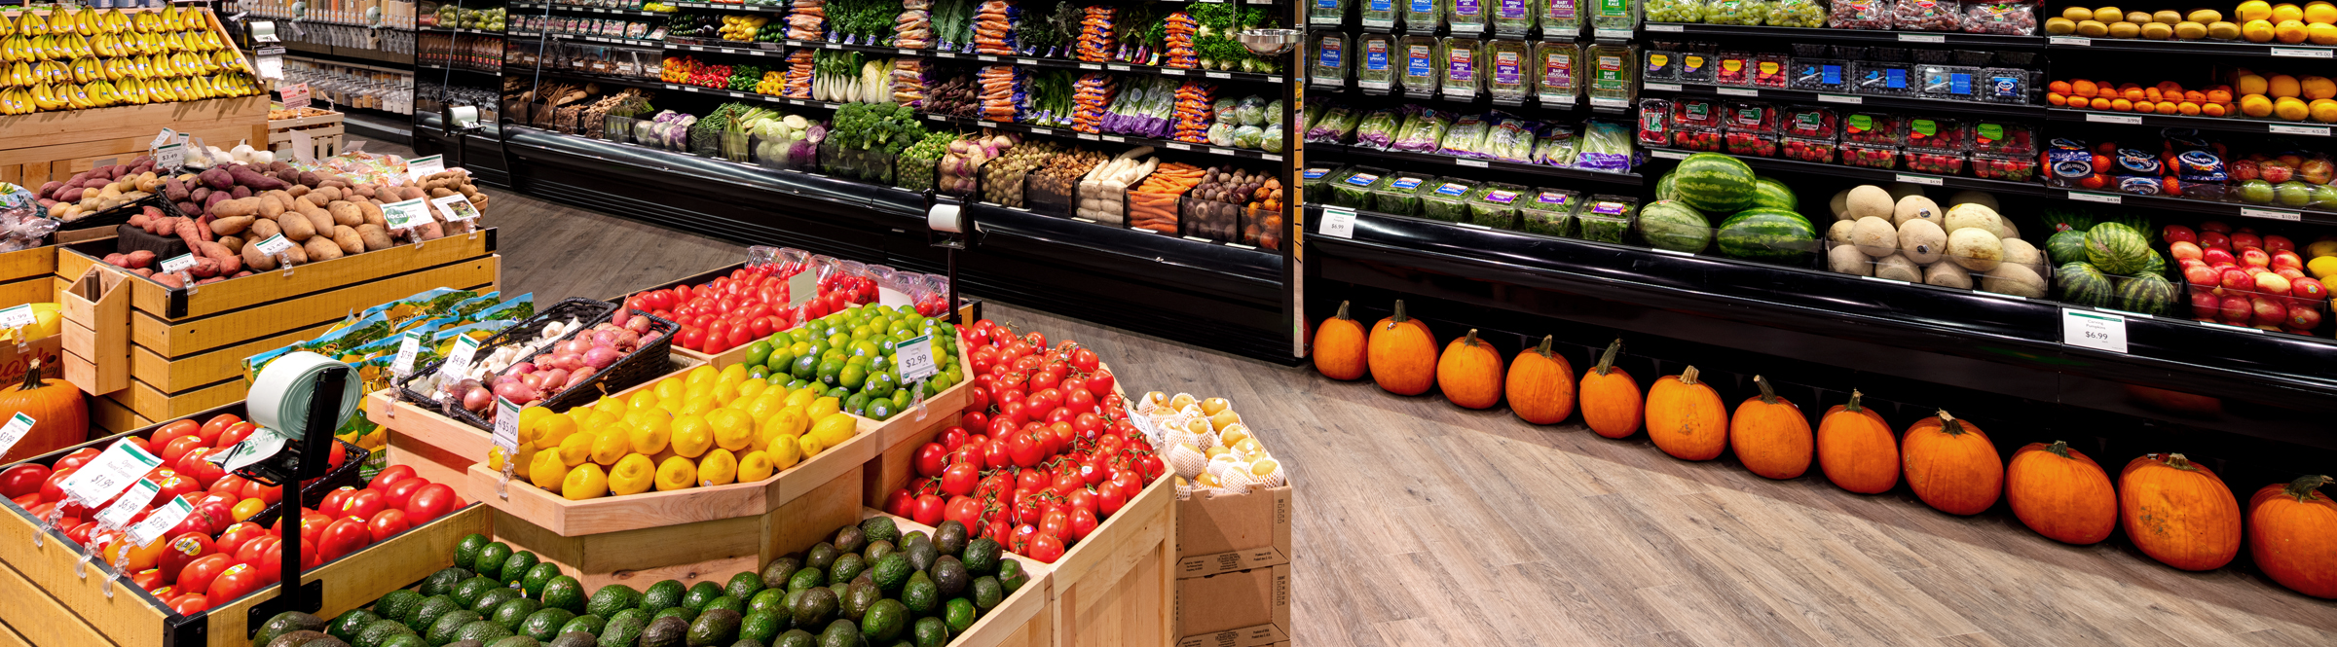
What Our Customers Say
UNFI Equipment Services should absolutely be a part of any retailer’s remodel or new store efforts. Many of the buying programs they have negotiated with major equipment suppliers are second to none. The team they have assembled is as good as the equipment they provide. They are always there to troubleshoot any issues long after the sale is complete. - Mike Jutz – Jerry’s Enterprises Inc.
I wanted this to be the best store in Mississippi and I believe we accomplished that goal. The response has been incredible, and sales have been awesome. - David Roberts – Corner Market
I love the fact we had all these years of experience supporting us in this project with these amazing fresh modern ideas with ways to incorporate the history of our community. - Kristen Rabourdin – The Market @ 25th
We wanted to thank this team for the amazing work on this project and all the help along the way. Building a store amid all this craziness in the world... not easy! But we did it! Very thankful, very appreciative. Our partnership with UNFI is long, and meaningful. - Eli Goldsmith - Healthy Living Market - Williston, VT
UNFI was very easy to work with. I was able to contact them whenever for the support I needed. During a remodel project, UNFI was able to provide what we needed at a fair price, with support to help us from planning to installation. It was a great experience! - Sherry Meyers, Just Food Co-op - Northfield, MN

Slide 20
Contact Information and Marketing Videos
Store design & Equipment
Equipment Services Support
1-800-835-0165
equipmentservices@unfi.com
Customer Testimonials
https://vimeopro.com/user48556009/store-design-services
Our Design Process
https://vimeopro.com/user48556009/store-design-and-equipment
Décor Made Easy
https://vimeopro.com/user48556009/decor-made-easy/video/432933863
Wellness Center
https://vimeopro.com/user48556009/unfiproserv-health-wellness

Slide 21
Thank You.

